Slide 1

COVID-19 Effect on Global Economy

Slide 2
Potential Economic Impact of COVID-19
Direct Cost from Sickness & Mortality
Aversion Behavior
Government Mandates
Firm and Institutional Decisions
Consumer Choices
Health Sector
Education
Manufacturing
Retail Services
Trade & Transport
Short-Run Effect
Long-Run Effects
Wages & Income falls
Poverty hikes
Loss of Human Capital
Infrastructure Deterioration

Slide 3
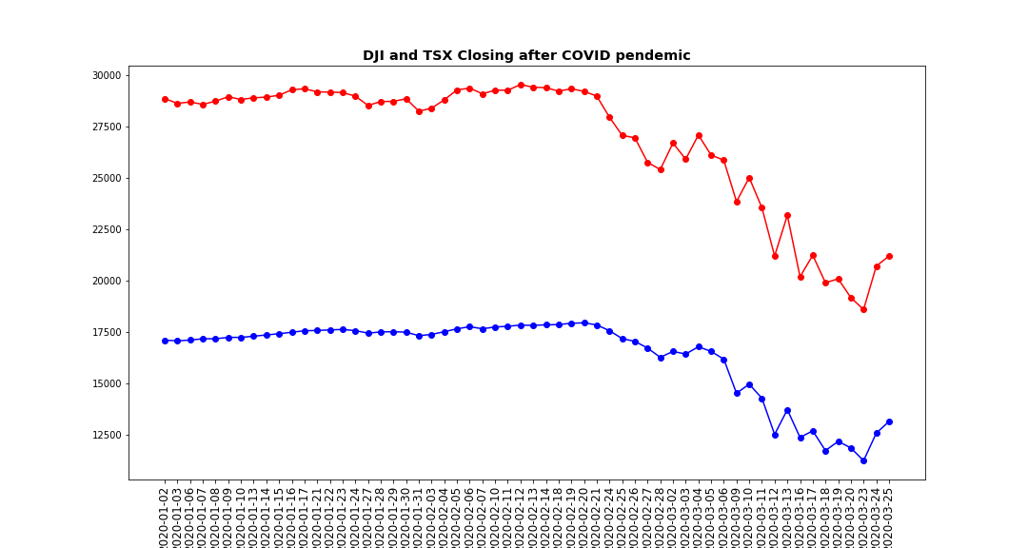
Assessing the economic impact of COVID-19

Slide 4
1) Travelers are cancelling flights 2) Business ask workers to stay home 3) Global Economy indexes are falling 4) More than 23,000 people have died worldwide, and >500,000 people are infected

Slide 5
COVID-19 effects on Canadian economy
Conference Board of Canada predicts that the COVID-19 will impact the country’s economy for years to come.
In comparison with our baseline scenario, the bigger negative impact on the Canadian economy is the result of lower energy and resource investment, weaker exports, and a drastic decline in household spending.

